Slide 1
Diabetic retinopathy prediction in patients

Slide 2
Diabetic retinopathy prediction in patients Business Objective: The variable to be predicted has two values (positive or negative on diabetic retinopathy). Thus, this is a binary classification project. The goal here is to predict whether a patient will suffer from diabetic retinopathy or not, conditioned on blood test features. Data Set Details: Target variables has two values in a classification project type: 0 (false) or 1 (true). The number of instances (rows) in the data set is 6000, and the number of variables (columns) is 6. The following list summarizes the information of the variables 1)ID: Numeric 2)age: (numeric). 3)systolic_bp: (normal range: below 120mmHg). When the heart beats, it squeezes and pushes blood through the arteries to the rest of the body. This force creates pressure on the blood vessels, and that is the systolic blood pressure. 4)diastolic_bp: (normal range: lower than 80mmHg). It is the pressure in the arteries when the heart rests between beats. This is the time when the heart fills with blood and gets oxygen. 5)cholesterol: (normal range: between 125 and 200 mg/dl). It is a waxy, fat-like substance found in every cell in the body. 6)prognosis: (0 or 1) (Target). It is 1 if the patient has retinopathy and 0 if he doesn't.

Slide 3
Data set for the project works and instruction’s

Slide 4
What is Diabetic Retinopathy?
Definition: A diabetic eye disease that affects the retina due to prolonged high blood sugar levels.
Prevalence: Affects about 1 in 3 people with diabetes, especially in Type 1 and Type 2 diabetics.
Impact: Can lead to blindness if untreated.
Importance of Early Detection
Early detection and treatment can significantly reduce the risk of vision loss.
Screening programs and predictive models help identify at-risk patients early.

Slide 5

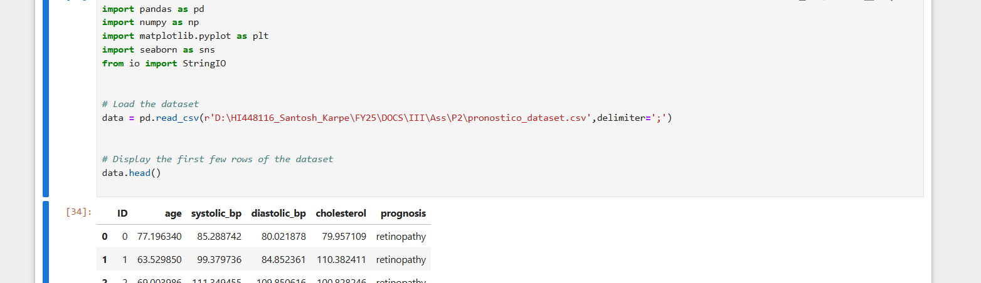
Read data set and formats

Slide 6

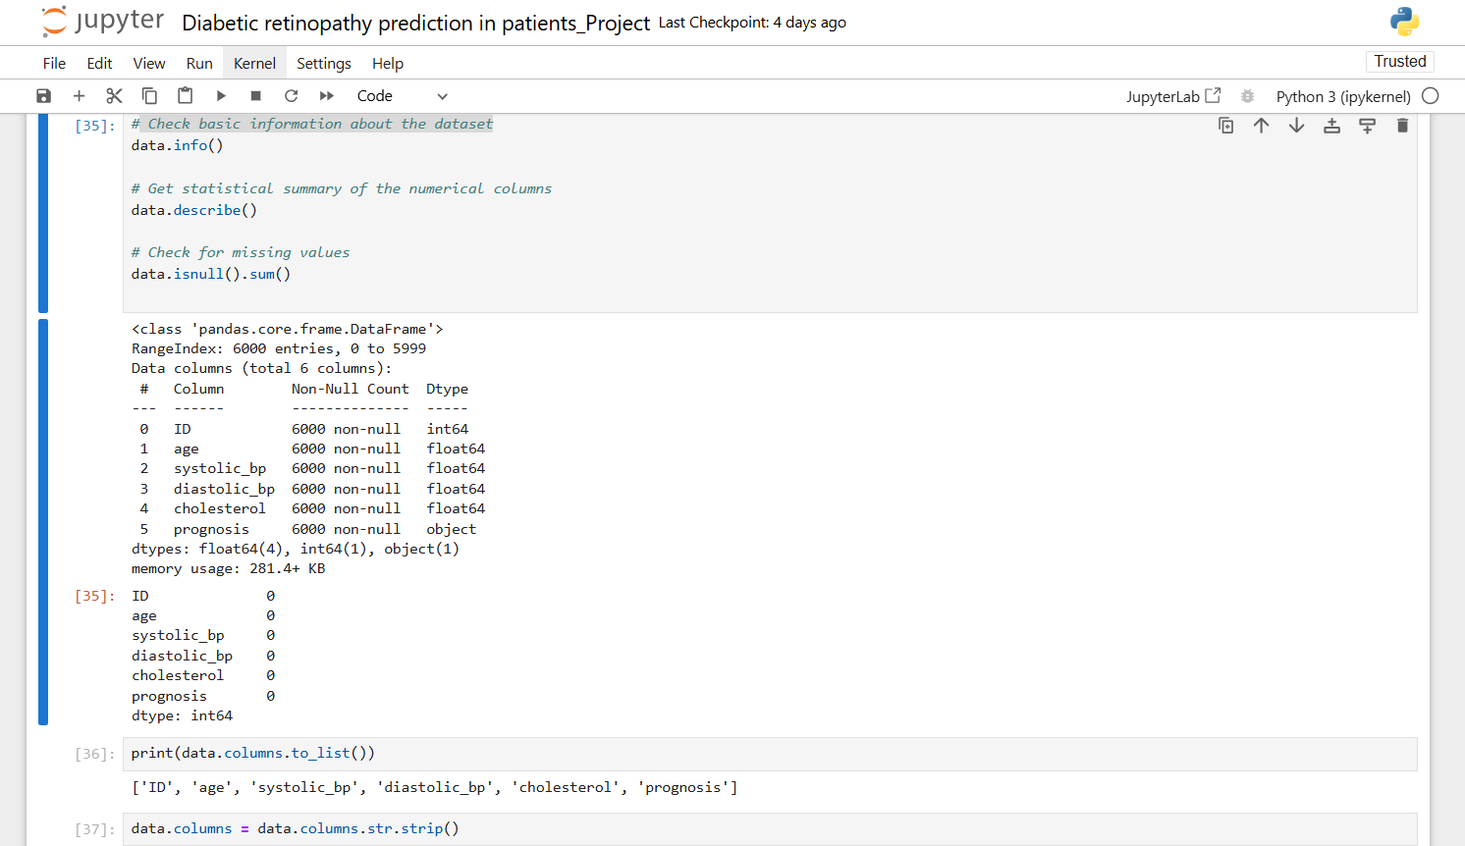
Check basic information about the dataset

Slide 7
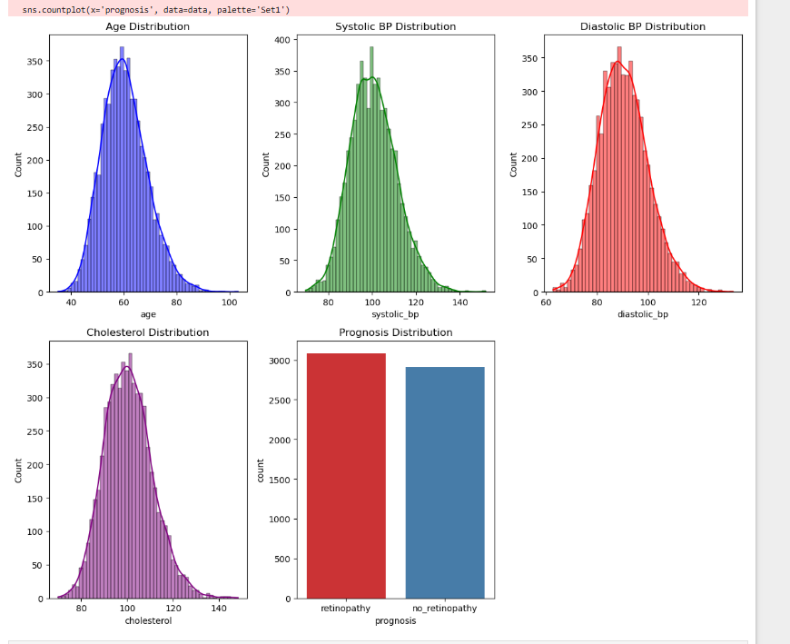
# Plot distribution for numerical columns

Slide 8
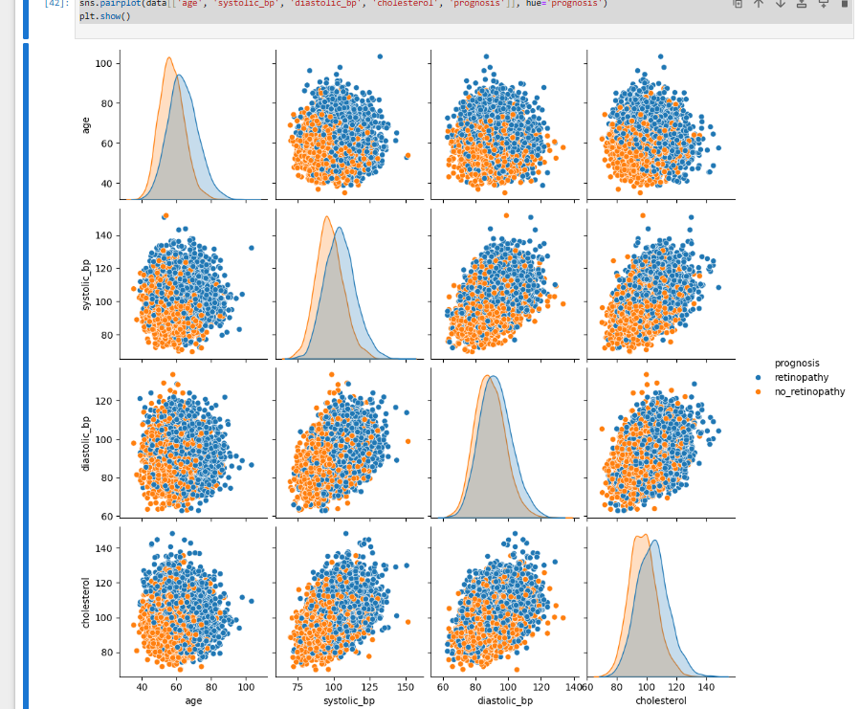
sns.pairplot(data[['age', 'systolic_bp', 'diastolic_bp', 'cholesterol', 'prognosis']], hue='prognosis')plt.show()

Slide 9
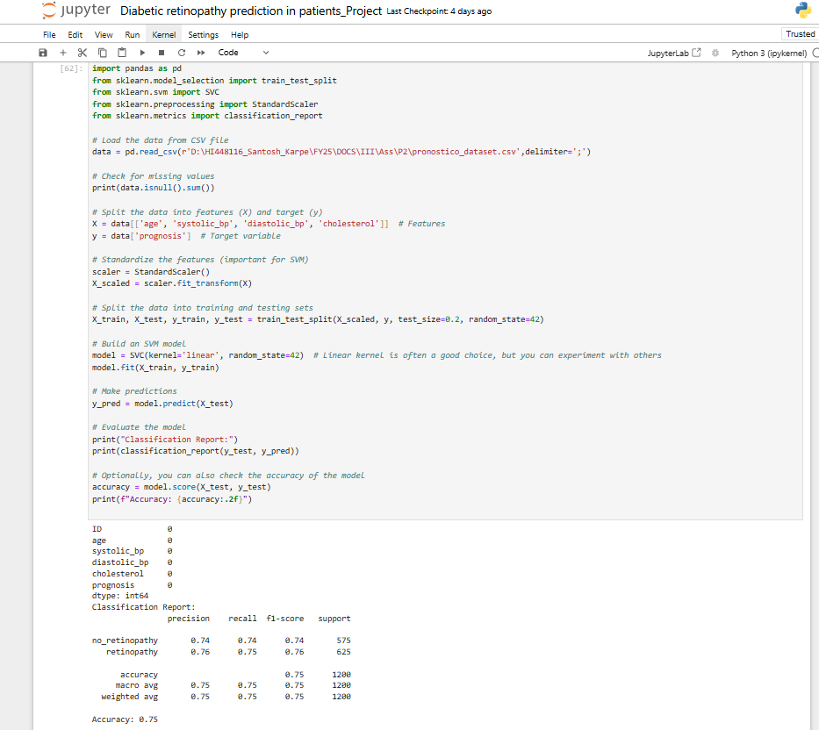
#Model Selection : SVM with Accuracy 75%

Slide 10
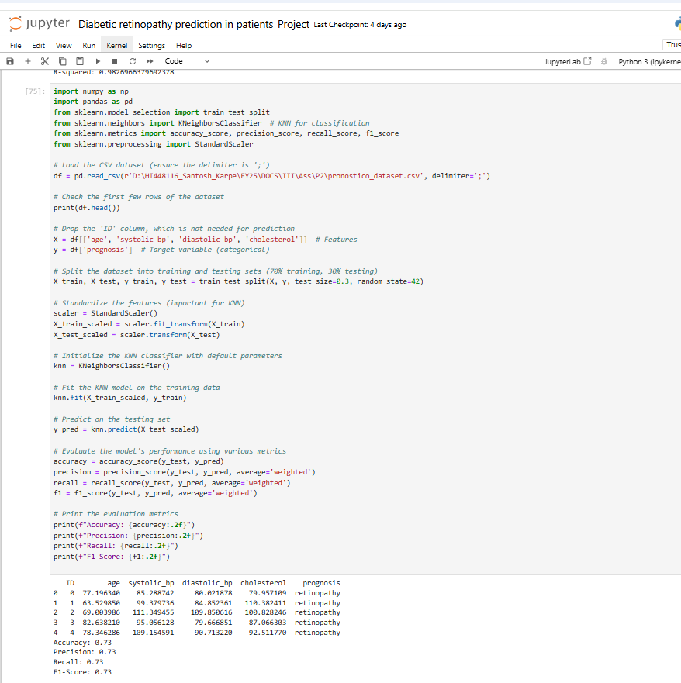
KNN classification for accuracy – 73%

Slide 11
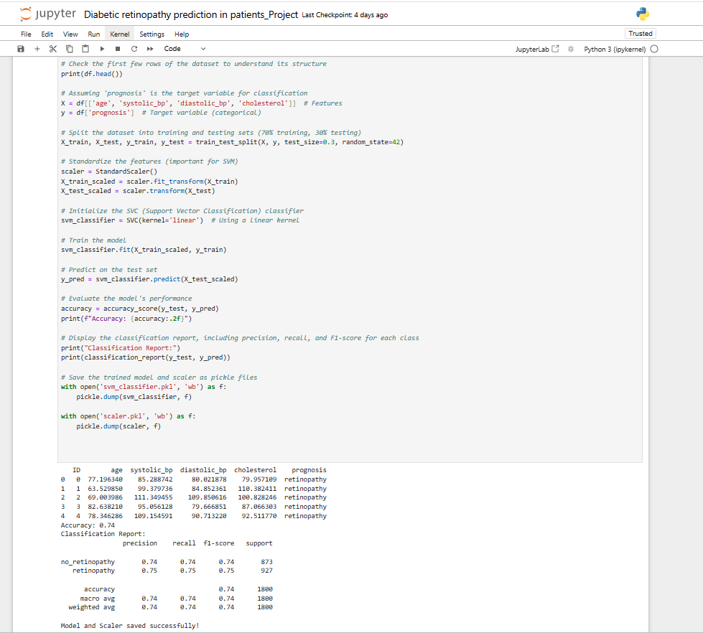
Model

Slide 12
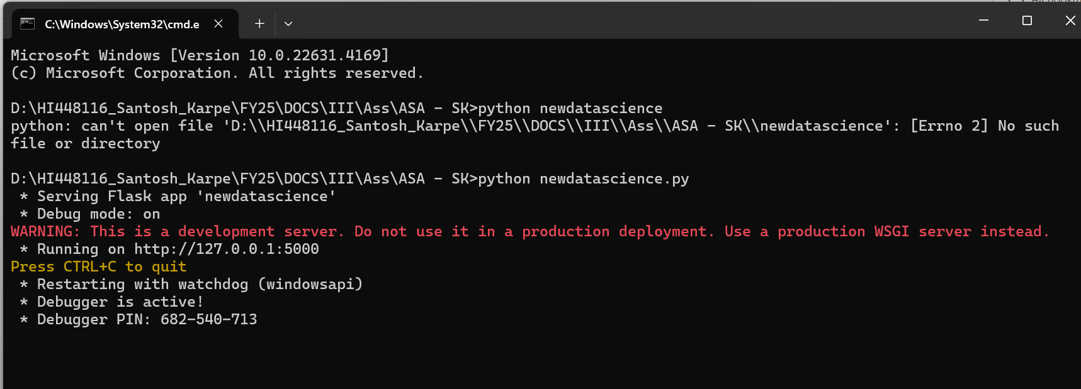
Model deployment

Slide 13
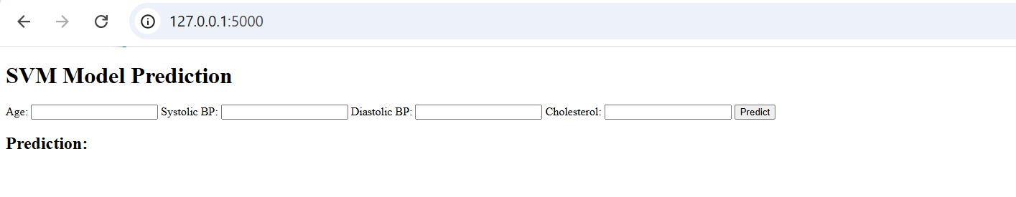
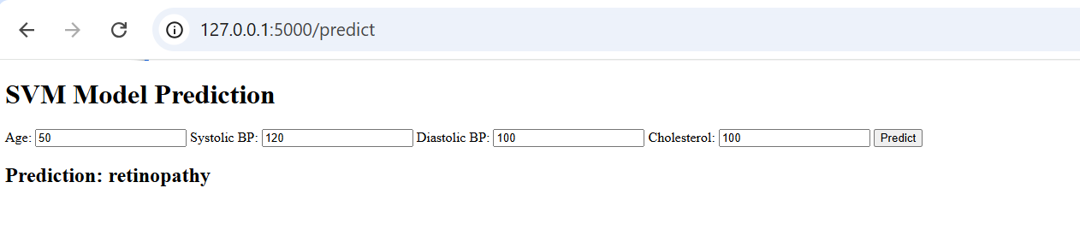
Model Implications – Main App

Slide 14
Thank You

